Slide 1

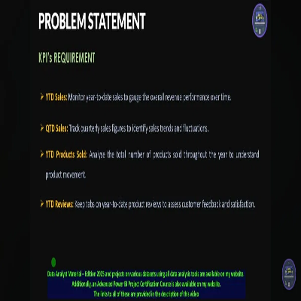
Sales Performance Project
Data Analysis & Visualization
A comprehensive analysis of sales KPIs, charts, and Power BI functionalities
August 2025

Slide 2
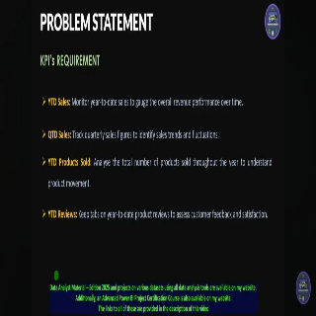
PROBLEM STATEMENT
KPI's REQUIREMENT
➤
YTD Sales:
Monitor year-to-date sales to gauge the overall revenue performance over time.
➤
QTD Sales:
Track quarterly sales figures to identify sales trends and fluctuations.
➤
YTD Products Sold:
Analyse the total number of products sold throughout the year to understand product movement.
➤
YTD Reviews:
Keep tabs on year-to-date product reviews to assess customer feedback and satisfaction.
Data Analyst Material – Edition 2025 and projects on various datasets using all data analysis tools are available on my website.

Slide 3
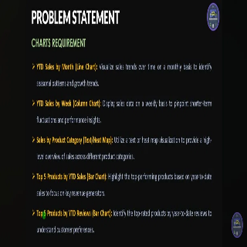
PROBLEM STATEMENT
CHARTS REQUIREMENT
➤
YTD Sales by Month (Line Chart):
Visualize sales trends over time on a monthly basis to identify seasonal patterns and growth trends.
➤
YTD Sales by Week (Column Chart):
Display sales data on a weekly basis to pinpoint shorter-term fluctuations and performance insights.
➤
Sales by Product Category (Text/Heat Map):
Utilize a text or heat map visualization to provide a high-level overview of sales across different product categories.
➤
Top 5 Products by YTD Sales (Bar Chart):
Highlight the top-performing products based on year-to-date sales to focus on key revenue generators.
➤
Top 5 Products by YTD Reviews (Bar Chart):
Identify the top-rated products by year-to-date reviews to understand customer preferences.

Slide 4

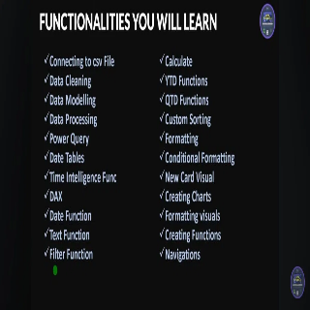
FUNCTIONALITIES YOU WILL LEARN
✓
Connecting to csv File
✓
Calculate
✓
Data Cleaning
✓
YTD Functions
✓
Data Modelling
✓
QTD Functions
✓
Data Processing
✓
Custom Sorting
✓
Power Query
✓
Formatting
✓
Date Tables
✓
Conditional Formatting
✓
Time Intelligence Func
✓
New Card Visual
✓
DAX
✓
Creating Charts
✓
Date Function
✓
Formatting Visuals
✓
Text Function
✓
Creating Functions
✓
Filter Function
✓
Navigations

